Slide 1

Phishing Website EDA
Ghadeer Ali Alghamdi

Slide 2
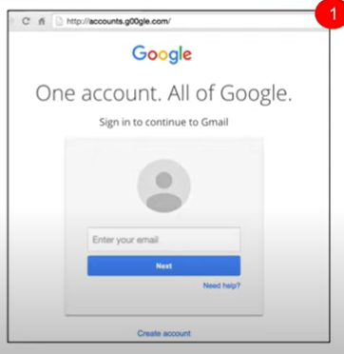
What do you think?
Phishing Website

Slide 3
Outline
Phishing Websites EDA
Problem Statement
01
04
Data Cleaning
Data Collection
02
05
Visualization and Findings
03
Data Extraction
03
06
Future Work
conclusion

Slide 4

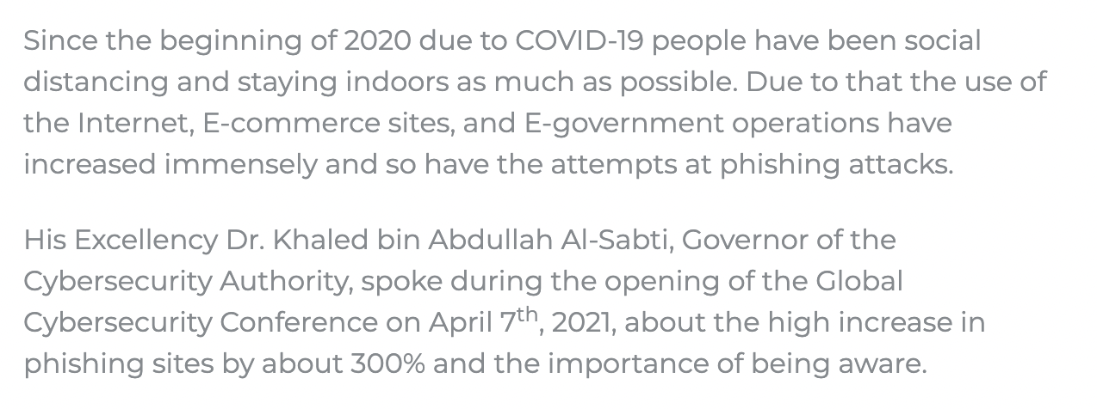
Why Phishing Websites?
Problem Statement

Slide 5

Is this A trusted link?
The aim of the Project
Find out the similar characteristics of phishing links
Measure the awareness toward this common cybercrime method.

Slide 6
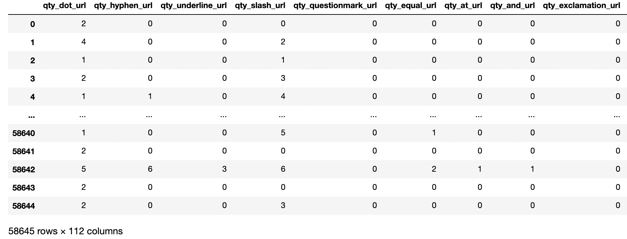
Data Collection
1. Phishing Websites Dataset from sciencedirect.com (2019)
It has 112 columns (Features) and 58,646 rows. which I will shrink them later to meet the expectations of my project.
Data type: (String, Integer)

Slide 7
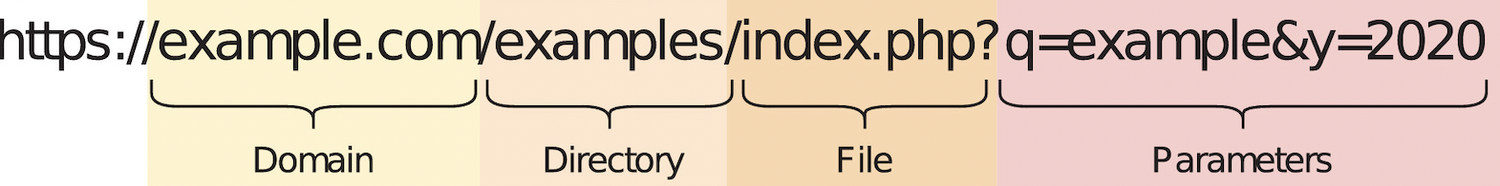
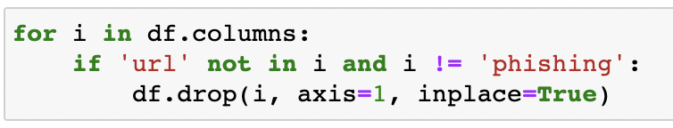
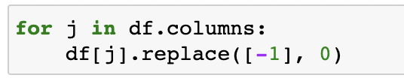

Data Cleaning
1. Drop
2. Replace
2. Rename

Slide 8
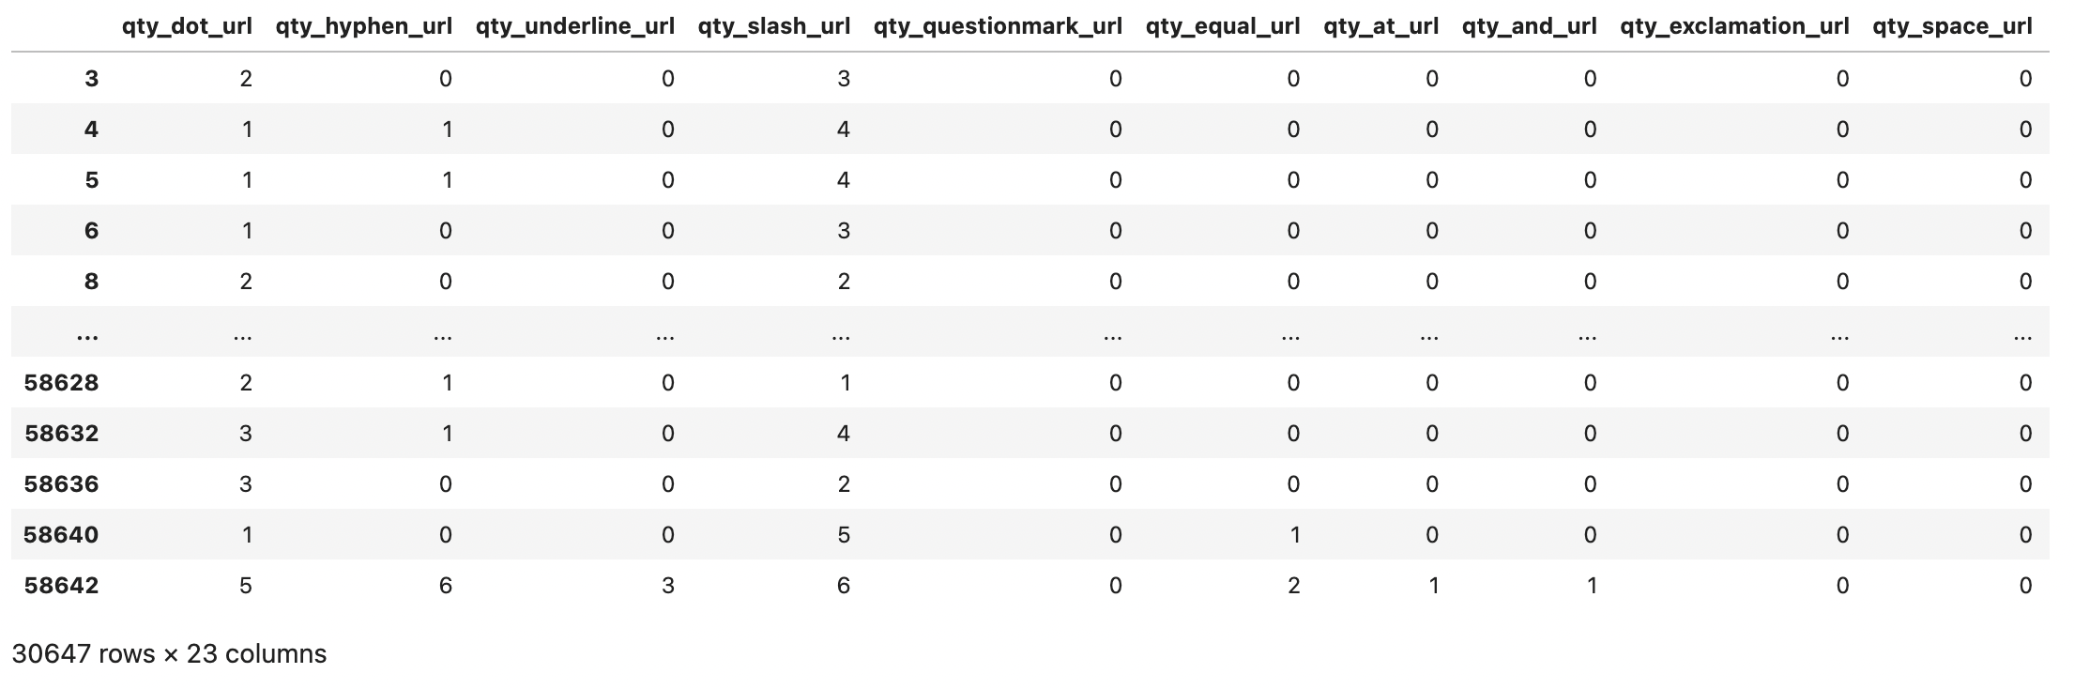
Data Cleaning
112 columns (Features) and 58,646 rows

Slide 9
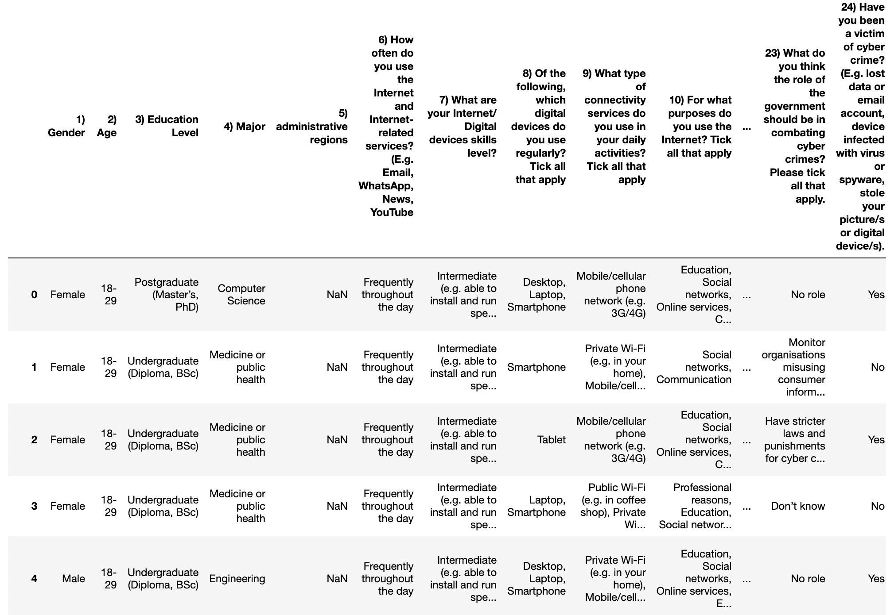
Data Collection
2. Cybercrime Awareness among Saudi Nationality from sciencedirect.com (Jun-2021)
It has 64 columns (Features) and 1,231 rows.
Data type: (String)

Slide 10
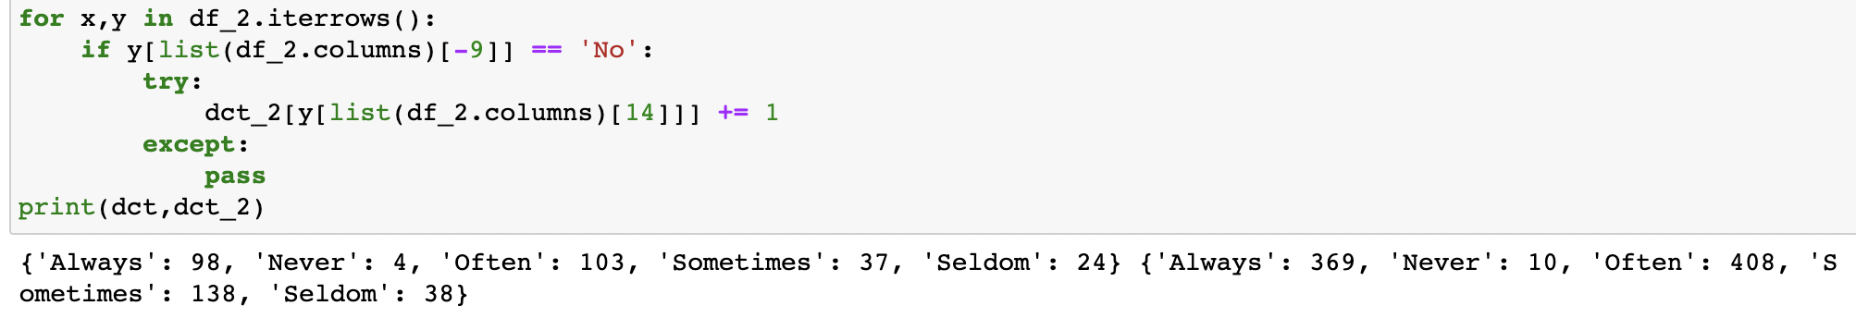
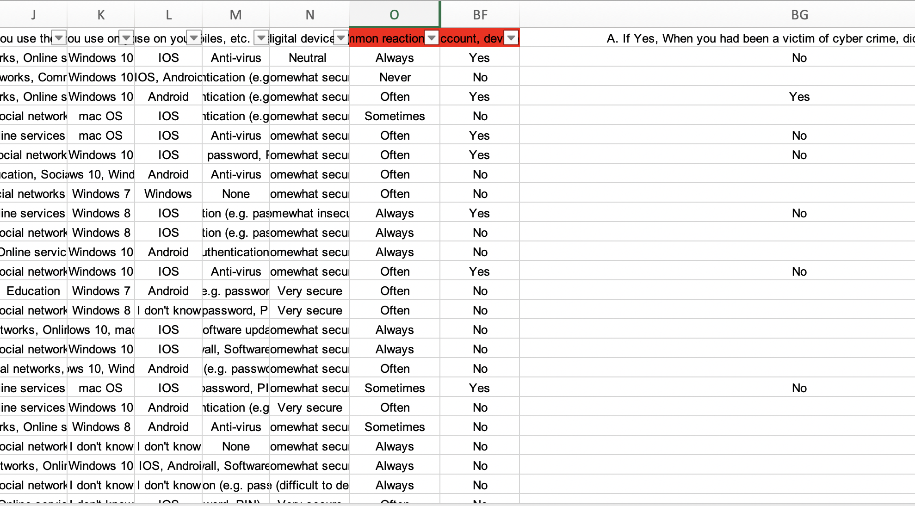
Data Cleaning
2. Cybercrime Awareness Datatset Extraction
64 Features become 2

Slide 11
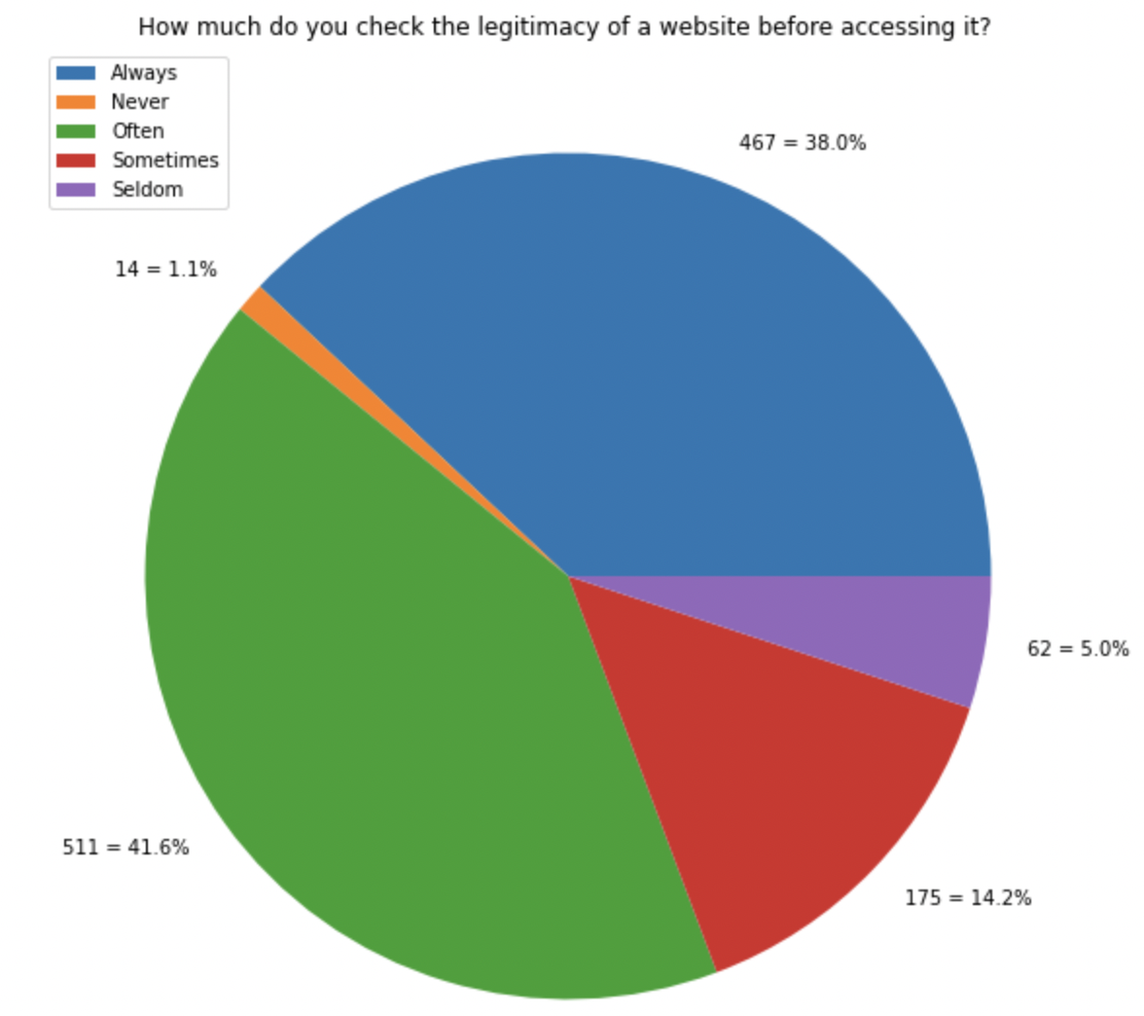
Visualization and Findings
Cybercrime Awareness

Slide 12
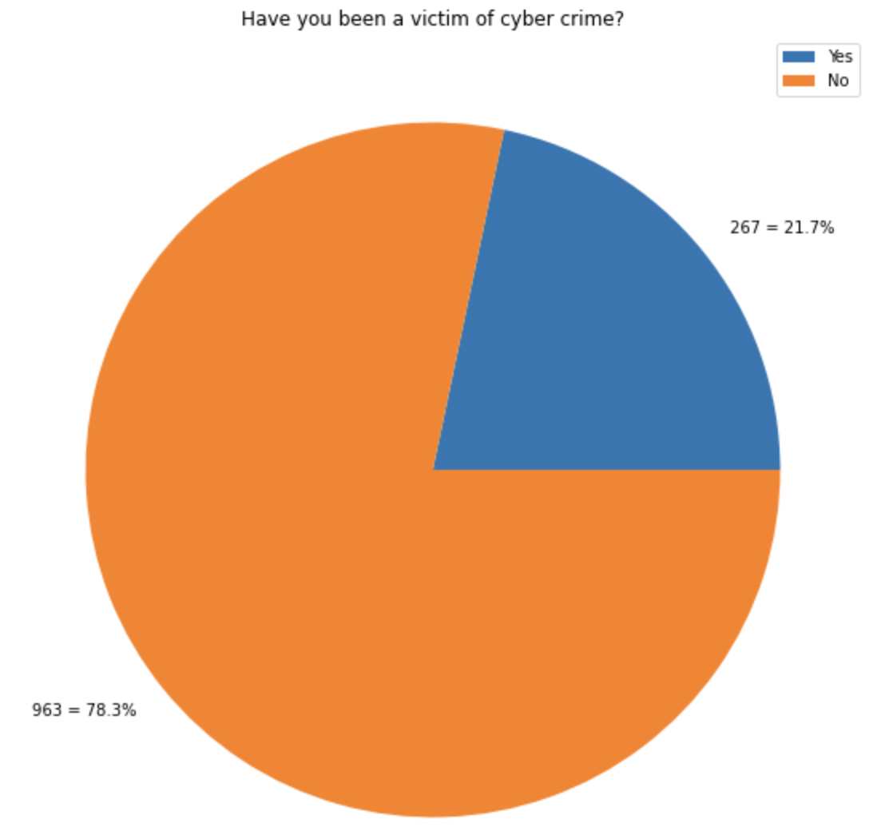
Visualization and Findings
Cybercrime Awareness

Slide 13
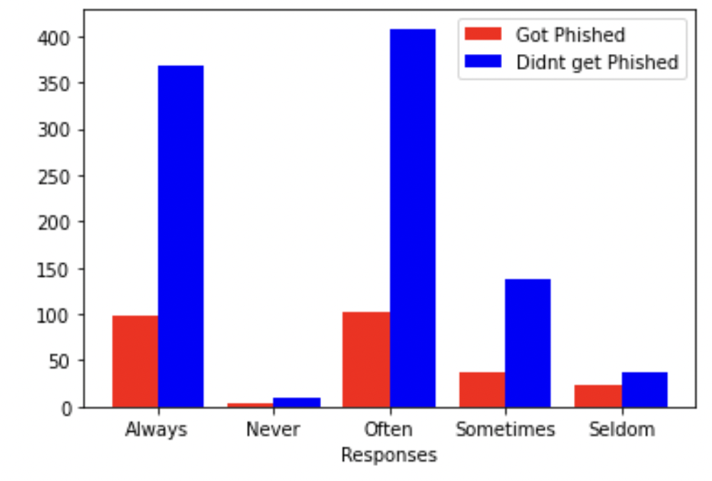
Visualization and Findings
Cybercrime Awareness

Slide 14
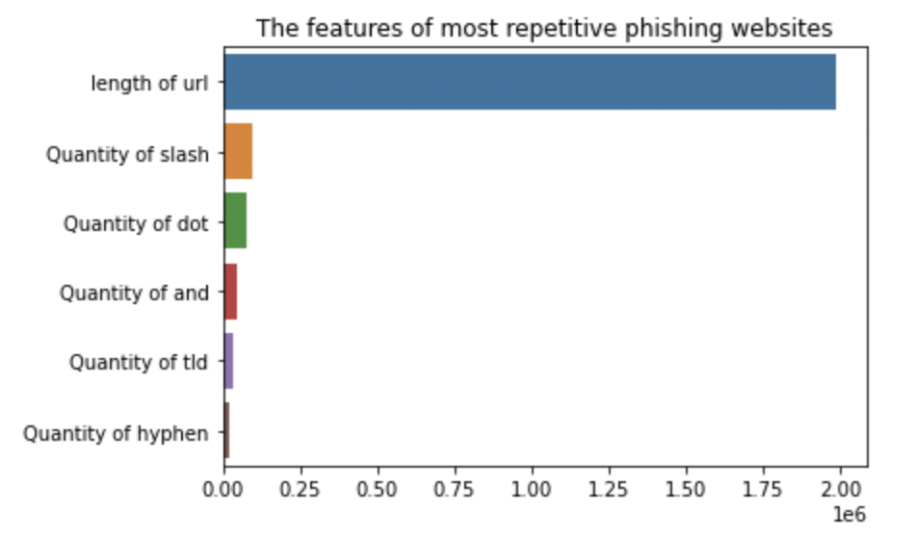
Visualization and Findings
Phishing Websites

Slide 15
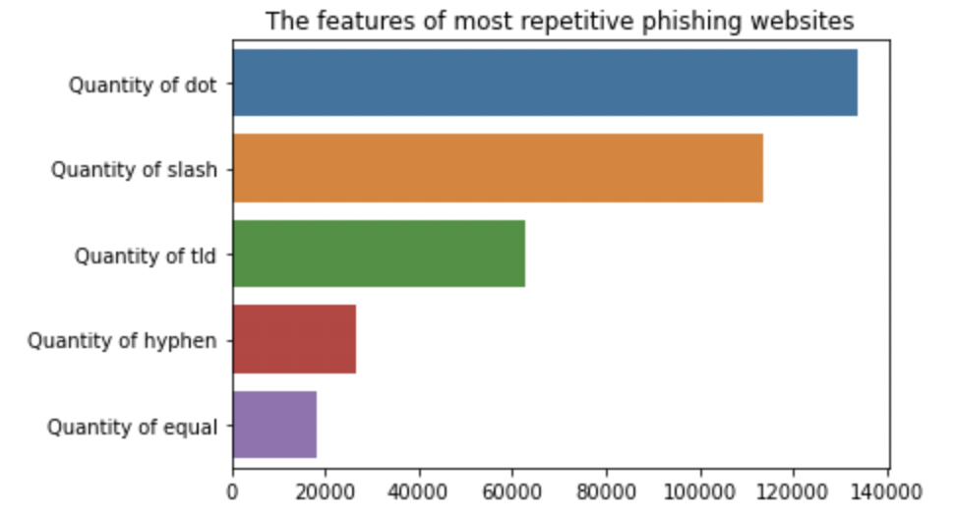
Visualization and Findings
Phishing Websites

Slide 16

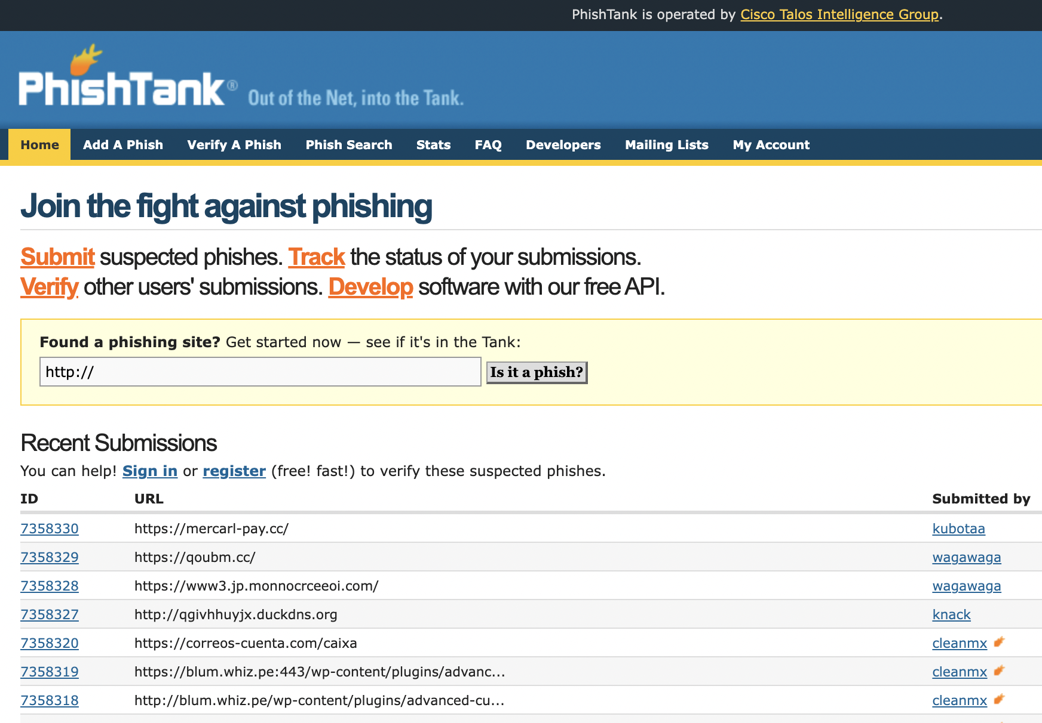
Future Work
Make a module that will allow the user to insert any link that he/she is suspicious about and represent how much out of 100% it's suspicious to be phishing.
Making huge local dataset of phishing websites similar to PhishTank.com

Slide 17
At Last but not least..
Thanks for listening..
Any Question

